Slide 1

KIDS LEARNING GAME
PYTHON PROJECT
BY –
SHYAM JAT
SHIVAM KUMAR SOURAV BHATIA
Submitted to-
Ms Gagandeep Kaur

Slide 2
INTRODUCTION
Nowadays parents want their kids to learn new things as soon as
possible. So, this kids learning game is for them. This game is based on
image recognition which attracts the kid to play this game more and
more and learn new things. This project is going to be developed using
python programming language which is very useful for making any user
interface other than C and C++. If any kid wants to learn animal names
then he or she can click on animals option and then can learn the
names of animals with the picture and they will get a chance to
recognize the photos also. There are so many other different learning
things contained in this particular game

Slide 3
PURPOSE
The purpose or objective of this project is to make kids aware of
different entities which we see in our daily life. Children likes playing
games, so this project is based on that scenario that will attract more
kids whatever their parents teaches them they can implement it during
the time or playing this game. For example, if parents taught them
animal names, then they can check the kids knowledge using the
animal recognition section of this game and take different tests of their
kids. If, they taught their kids names of body parts then they can
implement in the image recognition part of this game

Slide 4
Functionality
i.This game will help the kid to recognize the different type of
objects or entities we see in our day to day life.
ii. Kids will learn different names as well as it will help them to
increase their vocabulary.
iii. They will enjoy playing games as the interface is so attractive.
iv. They can learn the letters, numbers, alphabets, names of a wide
variety of objects around them using this particular game.
v. As at early stage of life the brain is in developing stage and learn
things quickly, playing this game kids will get a great help in
boosting their memory strength.

Slide 5
MODULES
Gallery: It will Store all the images in a file and direct it to the
screen for the image recognition function for the kids.
Name: It will store all the names of the images stored in the
notepad file and to direct at least 4 options on the screen below
the images.
Solution: It will provide the option to select the correct answer
out of 4 options and click on submit button after choosing the
option.
Result: it will provide the correct option or the name of images on
the screen. If kids had selected correct option then show answer
is correct else show the right answers with the statement wrong
answers.
Interface: To create the interface or the homepage of the kid
learning game ie to make the exact structure of the game.

Slide 6
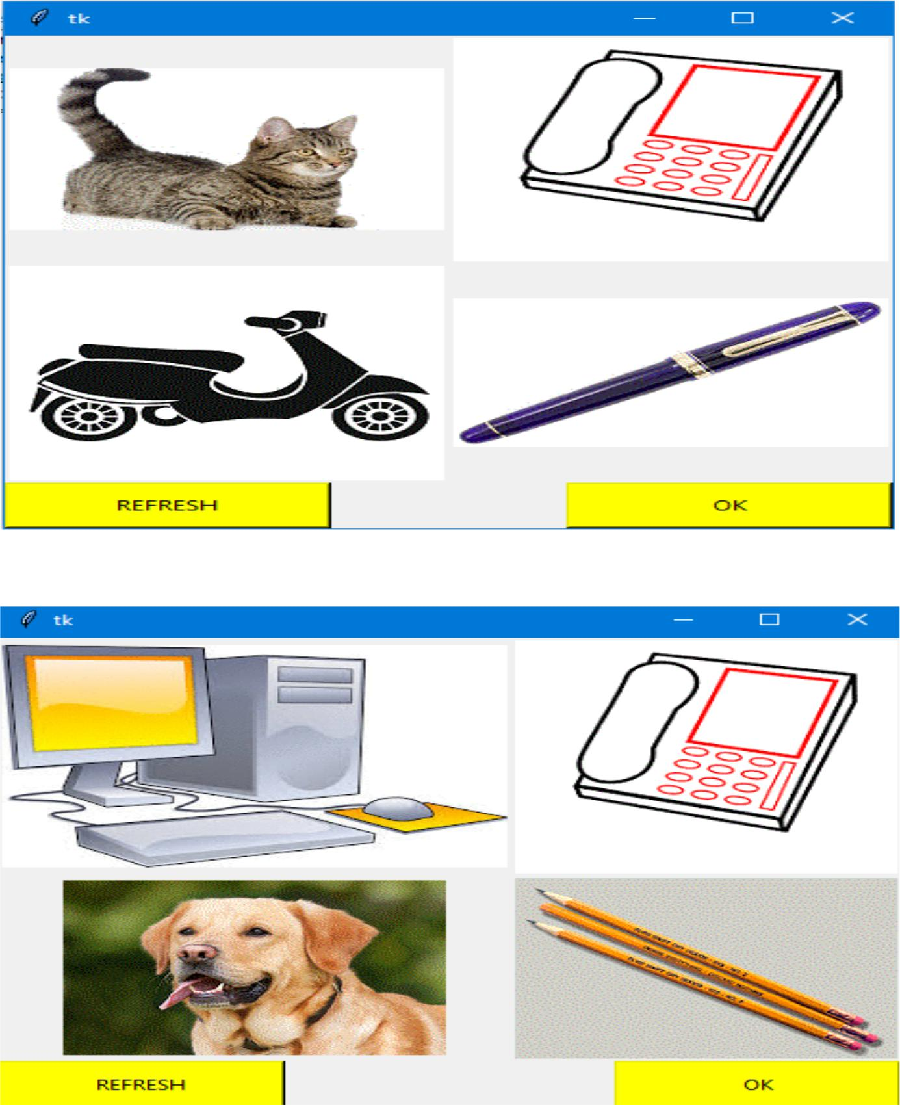
GUI

Slide 7
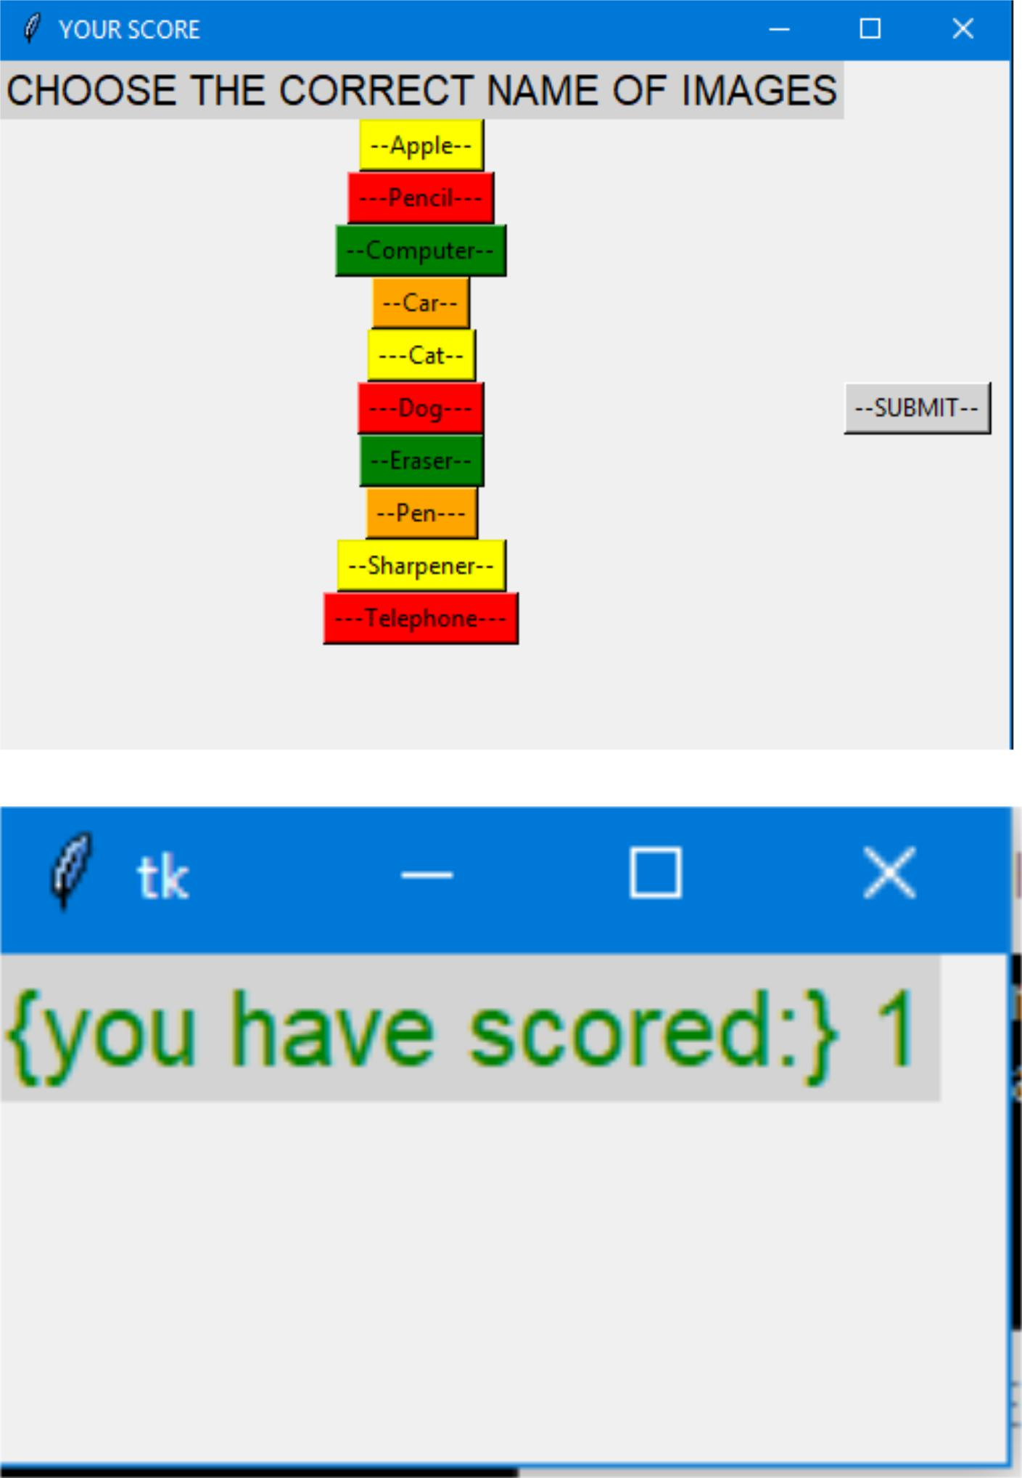
GUI

Slide 8
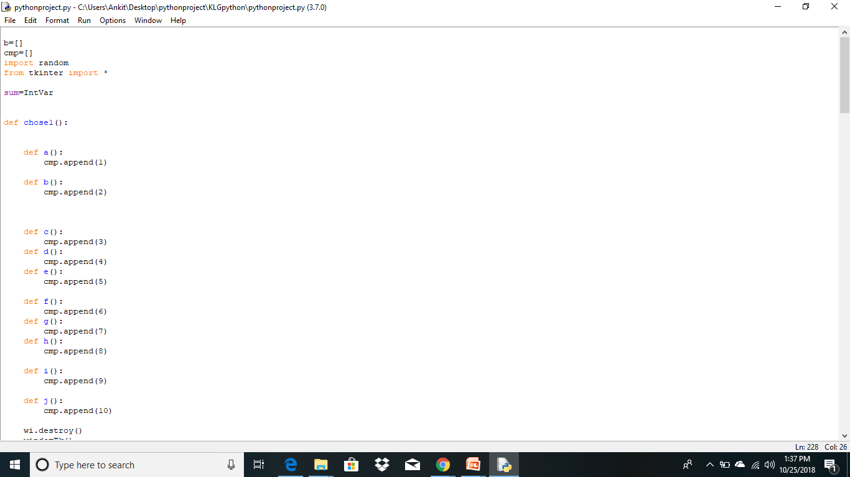
Source Code

Slide 9
RESULT
The first page of our project shows 4 images with 2 buttons which represent refresh and ok. refresh button will refresh the page with 4 different images. if the child will click on ok button then it will show 10 option to choose in which 4 options are correct and the submit button is there to submit the option and clicking on submit will move to the new page which will show the no of correct images and which all images were correct

